Slide 1
BCOG 200
Lecture 12
Supervised Classification

Slide 2
Lecture Topics
Review Supervised Learning
Discuss the importance of knowing (and normalizing) your features
Discuss overfitting and cross validation

Slide 3
Supervised Learning vs. Unsupervised Learning
Unsupervised Learning - You have some data, and and no teacher or feedback or explicit goal, and you are just trying to organize the data
Supervised Learning - You have some data, and are being explicitly told some relationship you are trying to learn

Slide 4
Examples of Supervised Learning
Regression
Using categorical or continuous data to predict continuous data
As scientists, we might be interested in the predictors of happiness, depression, school success, artistic skill, financial success, when those things are measured on a continuous scale
As humans, we might be interested in “how much” we will like this pizza, this tv show, this musical artist, or this person as a friend or romantic partner.
Classification
Using categorical or continuous data to predict categorical data
As scientists, we might be interested in the predictors of whether someone will finish school, get COVID-19, be a victim or perpetrator of a crime, or vote for Donald Trump.
As humans, we might be interested in the same set of questions as above, but posed in a binary way: will I like this pizza, will I like this TV show, will I like this person.

Slide 5
Classification - K Nearest Neighbors
Suppose we want to predict the color of the gray dot.
1) Pick a number for k.
2) Find colors of the k nearest neighbors in space.
3) Guess that the most likely color of the grey dot is the color most frequent in the k nearest neighbors
Algorithmically:
Calculate the distance to all the dots
Sort them by distance.
Determine the most frequent color in the top k items in the sorted list
Time in air
Time in water
Advantages:
Easy to conceptualize and implement
Usually works pretty well
Disadvantages:
If the number of comparisons gets large, that’s a LOT of distances you have to compute
Each dimension weighted equally

Slide 6
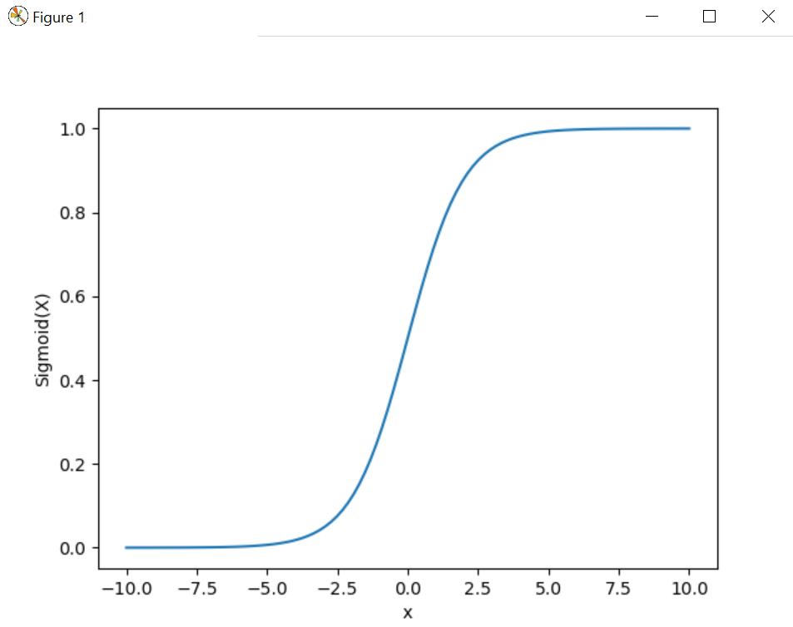
Consider this situation
Probability of Red = Ratio of Red to Yellow in k nearest neighbors
y = 1 .
1 + e^{-z}
where z = b₀ + b₁x₁ + b₂x₂
0.00 0.50 1.00
Time in air (x₂)
A z-value of 0 means sigmoid of 0.5, i.e. 50-50 chance
As z gets more negative, y quickly goes to zero
As z gets more positive, y quickly goes to one.
What we want our “supervised” learning model to do, is figure out what values of b₀, b₁, and b₂ let us guess, given any x₁ and x₂, the correct value of y (0 or 1).
In this case, we want something like: b₀ = -0.5, b₁ = 1, b₂ = 0
0.00 0.50 1.00
Time in water (x₁)

Slide 7
Classification Boundary
For a trained model, good b’s (meaning good classification performance) means we have effectively figured out a good classification boundary.
0.00 0.50 1.00
Time in air (x₂)
0.00 0.50 1.00
Time in water (x₁)

Slide 8
x₁ | x₂ | y
0.60 0.70 0.65 0.51 0.52 0.63 0.70 0.72 0.75 0.72 0.41 0.42 0.31 0.45 0.25 0.47 0.48 0.45 0.47 0.39 | 0.10 0.15 0.18 0.20 0.25 0.90 0.85 0.82 0.80 0.75 0.10 0.15 0.18 0.20 0.25 0.90 0.85 0.82 0.80 0.75 | 0 0 0 0 0 0 0 0 0 0 1 1 1 1 1 1 1 1 1 1
1
b₀
x₁
y
b₁
Algorithmically:
Set the weights to random values close to zero (but not exactly zero)
For each item in the training set:
Make a prediction
Compare it to the actual value
Adjust the weights to make guess for that item more correct in the future
x₂
b₂
b₀ | b₁ | b₂
0.05 | -0.05 | 0.01

Slide 9
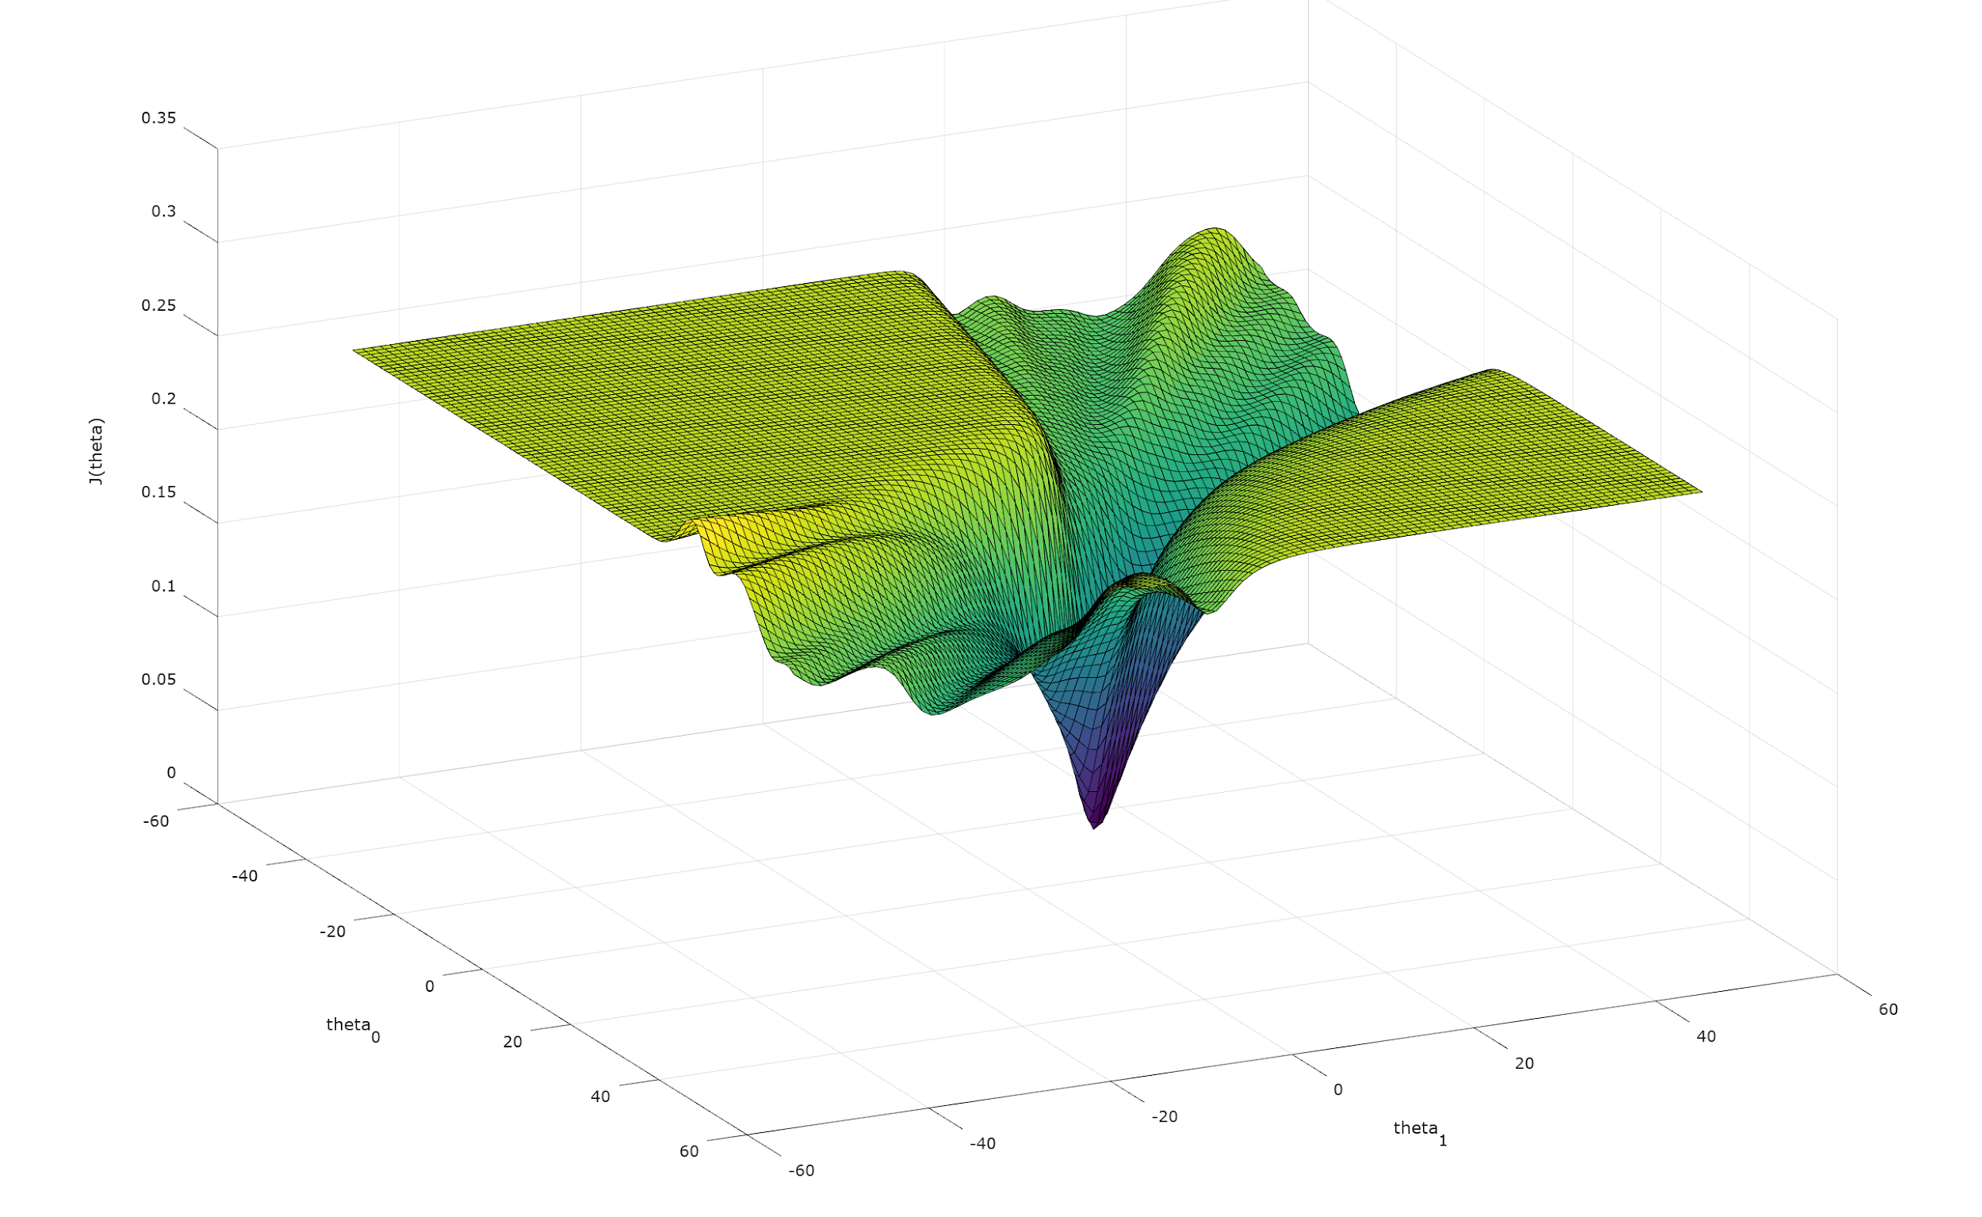
Error Surface

Slide 10
Extending to Many Dimensions
1
y₁
Mammal
Bird
Reptile
Fish
Time in Air
Time in Water
Time Land
Wing Size
Arm Size
Fin Size
x₁
y₂
x₂
y₃
x₃
y₄
x₄
x₅
x₆

Slide 11
Feature Normalization
We are trying to get the network to learn which dimensions matter.
But if something about our data biases certain dimensions, this can make it hard for machine learning algorithms to learn.
Time Spent in Air | Length of Wings | Category
0.01 0.02 0.03 0.80 0.90 0.85 | 0.0 0.0 5.0 6.0 5.5 5.2 | 0 0 0 1 1 1

Slide 12
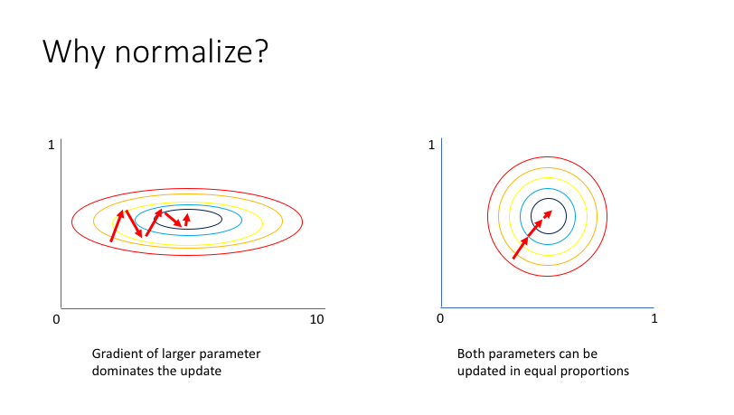
Feature Normalization

Slide 13
Overfitting
Imagine you had 10,000 features you could keep track of for each object.
Would that be good or bad.

Slide 14
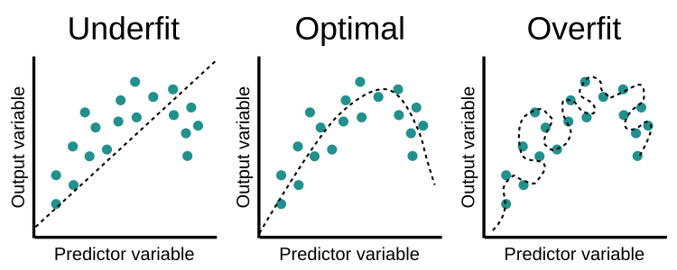
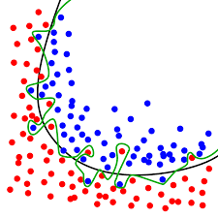

Slide 15
Cross Validation
Divide data into a training set and a test set.
Then train your model (and determine your b’s) using the training set.
Then test on the test items.
If it still does well, great! This means your b’s are probably not overfit, and will generalize well to new data.

Slide 16
